Slide 1
Implementing bandit learning with CRFs on structured linguistics data
Chris Lo, Dec 3 2015

Slide 2



Bandit/online learning recap
Typical process:
observe one example
predict
suffer loss
improve the model
repeat
Notes:
receives partial information in terms of feedback to a single predicted point.

Slide 3
Expected loss
Full information expected loss:
Bandit learning expected loss:

Slide 4
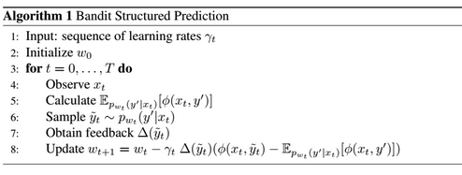
Bandit Structured Prediction algorithm
We assume:
• a sequence of input structures x_t for t = 1, … ,T that is generated by a fixed, unknown distribution.
• this distribution is a is log-linear model

Slide 5
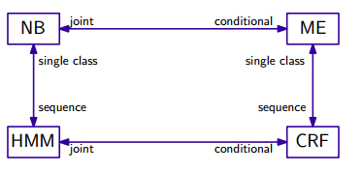
What are Conditional Random Fields and why are they relevant?
Task: Sequential labeling tasks such that there is correlation between elements in the sequence, such as letter recognition (OCR), text chunking (“shallow parsing”).
A few related classification models:

Slide 6



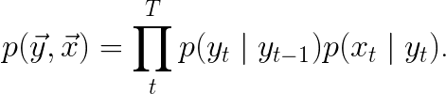
Maximum Entropy, HMMs
Maximum Entropy: Maximize subject to
yields:
Hidden Markov, a sequential version of Naive Bayes:

Slide 7
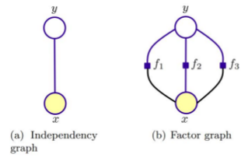
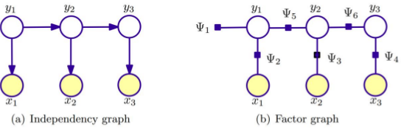
Graphical representation
Maximum Entropy
HMM

Slide 8
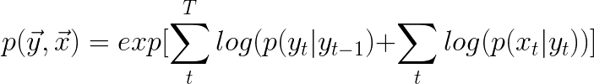
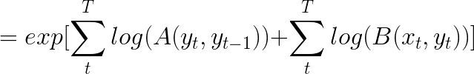
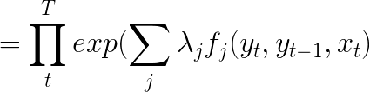
From HMMs to CRFs, a common derivation
Define features:

Slide 9
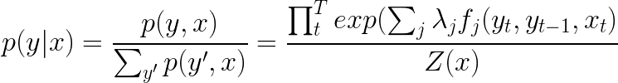

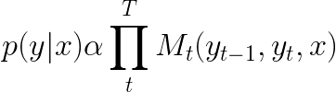
From HMMs to CRFs, a common derivation
Okay, let’s bring out the “conditional” in CRFs...
Further compress the notation:

Slide 10

How should we interpret this new model?
Lesson learned: don't interpret as “conditional form of HMMs” with transition and emission probabilities!
Interpret as, instead:
• Think of M as potentials for an undirected graph structure:
Cliques: induced subgraph is complete
Potential functions do not have to be probability functions (different than directed graph structure)
• A sequential maximum entropy model

Slide 11
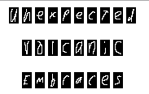
Our (first) task: Optical Character Recognition
Our dataset: sequences of handwriting images (128 pixels) associated with sequences of text labels, from Rob Kassel at MIT Spoken Language Systems Group. Each sequence/word is about 5-10 letters length.

Slide 12
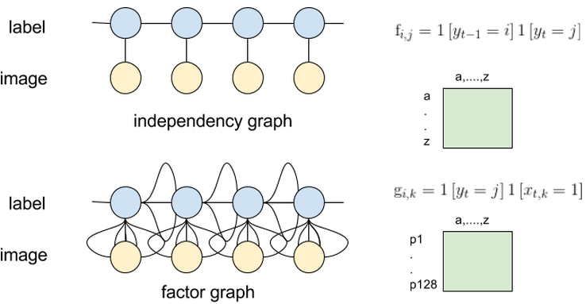
Reformulating the OCR problem into CRFs
We also add two additional types of features: “start” and “stop” features
• What is most probable letter to start or end a word in the dataset?
• Other implementations have a {start, end} state, but that requires constructing extra nodes and states.

Slide 13



Inference of CRFs
Turns out, the zeros of partials of the log-likelihood require: for all k features: the empirical distribution expectation and model distribution expectation need be equal. We will need to compute:

Slide 14




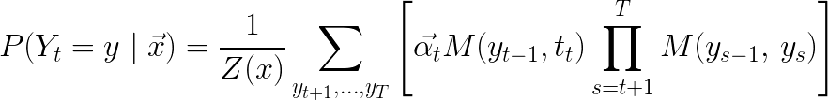
Forward-backwards algorithm for CRFs
Recall, in HMMs, and , but it’s a bit different here. Consider expanding….
Consider just the first summations:
with HMM’s definition of alpha

Slide 15





Forward-backwards algorithm for CRFs
Then, we do the same thing for the last summations:
where

Slide 16
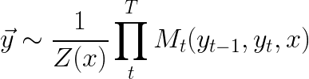
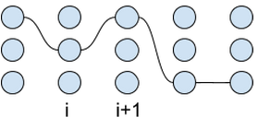
Obtaining feedback
We need to sample the model distribution
will do.

Slide 17

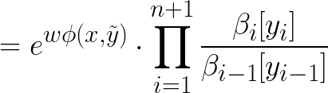
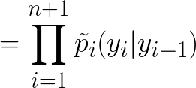

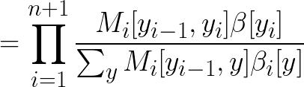
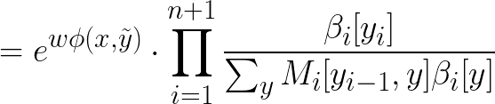

Obtaining feedback

Slide 18
Actual Implementation
• Peered into several popular CRF packages: pystruct, wapiti, CRF++, crfChain,
• Binary vs. categorical features,
• Ability to sample
• Only pystruct can use binary features, but not categorical features. Not very fast so...
• I rewrote everything in C++

Slide 19
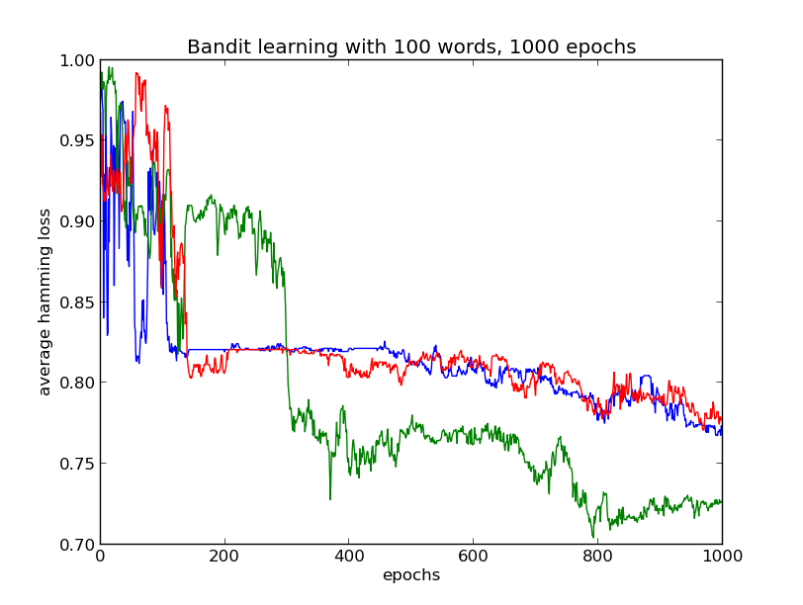
Some results

Slide 20
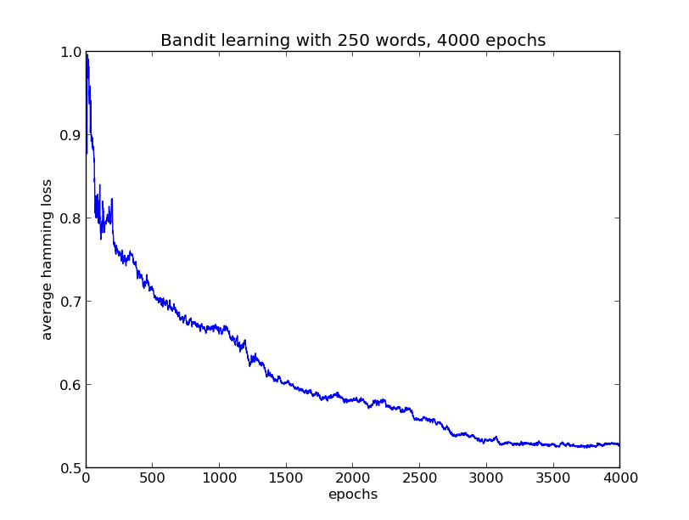
Some results

Slide 21
Other improvements
Domain Adaptation
Annealing
Regularization
Adaptive learning rates - learning rate per feature

Slide 22

Chucking experiment
Input: words, and its annotated POS tags.
Labeling/output: Noun phrase chunking, ie:
B, I, I, B, I, I, O, B, O, B, I, I, O.
Sha & Pereira, “Shallow Parsing with Conditional Random Fields”.
Second order Markov dependencies for labels.

Slide 23
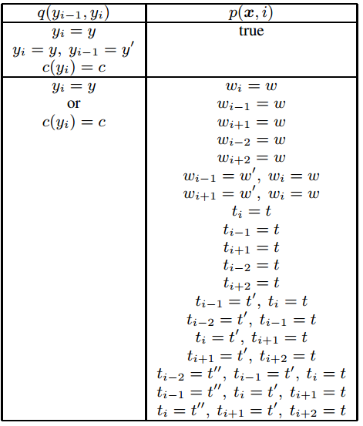
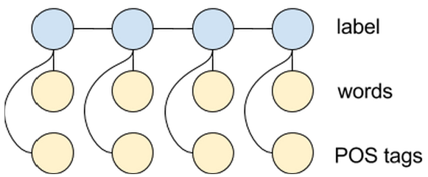
Chunking Task Features

Slide 24
...In the process of implementation!
Thank you!

